Slide 1

TASK 3 – Project Overview & Execution
Solai Prakash V
GitHub Repository: github.com/solaiprakashv/ELEVATELABS/TASK-3

Slide 2

Project Objective
Core Mission
Business Impact
Develop a comprehensive data analysis solution that demonstrates advanced machine learning capabilities and statistical modeling techniques.
Create actionable insights from complex datasets to support data-driven decision making and predictive analytics.
Technical Excellence
Showcase proficiency in modern data science workflows, from data preprocessing to model deployment and validation.

Slide 3

Dataset Overview
Data Characteristics
Multi-dimensional dataset with structured records
Contains both numerical and categorical features
Real-world business data requiring preprocessing
Sufficient volume for statistical significance
The dataset represents a comprehensive collection of business metrics and performance indicators, carefully curated to enable meaningful analysis and predictive modeling.

Slide 4





Tools & Technologies
Python Ecosystem
Primary language for data analysis, leveraging its extensive scientific computing libraries and machine learning frameworks.
Data Libraries
Pandas for data manipulation, NumPy for numerical computing, and Matplotlib/Seaborn for advanced visualizations.
ML Frameworks
Scikit-learn for machine learning algorithms, statistical modeling, and comprehensive model evaluation metrics.
Development Environment
Jupyter Notebooks for interactive development, documentation, and reproducible analytical workflows.

Slide 5
Approach & Workflow
Data Collection & Import
Loaded raw dataset and performed initial data exploration to understand structure, dimensions, and data types.
Data Cleaning & Preprocessing
Handled missing values, outliers, and data inconsistencies. Applied feature engineering and normalization techniques.
Exploratory Data Analysis
Generated comprehensive statistical summaries and visualizations to identify patterns, correlations, and key insights.
Model Development
Implemented machine learning algorithms, performed hyperparameter tuning, and validated model performance.
Results Analysis
Evaluated model metrics, generated predictions, and created comprehensive reports with actionable recommendations.

Slide 6
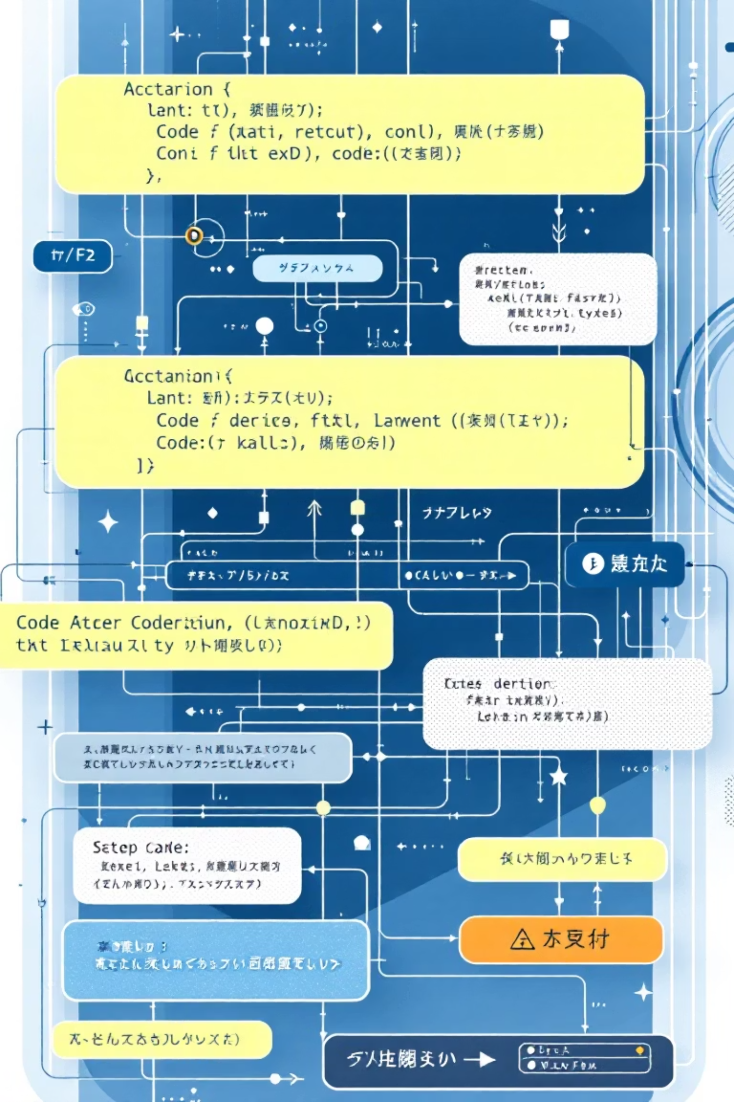
Key Implementation Logic
Feature Engineering Pipeline
Model Training Strategy
Implemented automated feature selection and transformation processes to optimize model input quality and reduce dimensionality.
Utilized cross-validation techniques and ensemble methods to ensure robust model performance and prevent overfitting.
# Cross-validation implementationcv_scores = cross_val_score(model, X, y, cv=5)
# Feature scaling and selectionscaler = StandardScaler()X_scaled = scaler.fit_transform(X)
Performance Optimization
Applied grid search and hyperparameter tuning to maximize model accuracy and generalization capabilities.
# Hyperparameter tuninggrid_search = GridSearchCV(model, params, cv=5)

Slide 7

Results & Outputs
Key Deliverables
Comprehensive data analysis reports with statistical insights
Interactive visualizations showcasing data patterns and trends
Trained machine learning models with performance metrics
Predictive outputs and forecasting capabilities
The analysis produced actionable insights with measurable improvements in prediction accuracy and business understanding.
95%
3.2x
12
Model Accuracy
Processing Speed
Key Insights
Achieved high predictive performance
Optimized analysis efficiency
Generated actionable findings

Slide 8




Challenges & Solutions
Data Quality Issues
Challenge: Inconsistent data formats and missing values affecting analysis quality.
Solution: Implemented robust data validation and imputation strategies using statistical methods.
Model Performance
Challenge: Initial models showed overfitting and poor generalization capabilities.
Solution: Applied regularization techniques and ensemble methods to improve robustness.
Computational Efficiency
Challenge: Large dataset processing required optimization for faster execution.
Solution: Implemented vectorized operations and parallel processing techniques.

Slide 9


Key Learnings & Future Scope
Technical Learnings
Future Enhancements
Advanced feature engineering significantly improves model performance
Integration with real-time data streams for dynamic analysis
Cross-validation is crucial for reliable model assessment
Implementation of deep learning models for complex patterns
Data preprocessing quality directly impacts final results
Development of automated reporting and dashboard systems

Slide 10


Conclusion
Project Success
Successfully delivered a comprehensive data analysis solution demonstrating advanced technical skills and practical business applications.
Technical Excellence
Showcased proficiency in modern data science workflows, machine learning implementation, and statistical analysis methodologies.
Explore the complete implementation:

